Slide 1
PROJECT PRESENTATION Micro finance PROJECT
Notes:
This template can be used as a starter file to give updates for project milestones.
Sections
Right-click on a slide to add sections. Sections can help to organize your slides or facilitate collaboration between multiple authors.
Notes
Use the Notes section for delivery notes or to provide additional details for the audience. View these notes in Presentation View during your presentation.
Keep in mind the font size (important for accessibility, visibility, videotaping, and online production)
Coordinated colors
Pay particular attention to the graphs, charts, and text boxes.
Consider that attendees will print in black and white or grayscale. Run a test print to make sure your colors work when printed in pure black and white and grayscale.
Graphics, tables, and graphs
Keep it simple: If possible, use consistent, non-distracting styles and colors.
Label all graphs and tables.

Slide 2
Project Overview
What is the project about?
Define the goal of this project
Data Collection
Notes:
What is the project about?
Define the goal of this project
Is it similar to projects in the past or is it a new effort?
Define the scope of this project
Is it an independent project or is it related to other projects?
* Note that this slide is not necessary for weekly status meetings

Slide 3
What is the project about?
A Microfinance Institution (MFI) is an organization that offers financial services to low income populations. MFS becomes very useful when targeting especially the unbanked poor families living in remote areas with not much sources of income. The Microfinance services (MFS) provided by MFI are Group Loans, Agricultural Loans, Individual Business Loans and so on.
Many microfinance institutions (MFI), experts and donors are supporting the idea of using mobile financial services (MFS) which they feel are more convenient and efficient, and cost saving, than the traditional high-touch model used since long for the purpose of delivering microfinance services. Though, the MFI industries is primarily focusing on low income families and are very useful in such areas, the implementation of MFS has been uneven with both significant challenges and successes.
Today, microfinance is widely accepted as a poverty-reduction tool, representing $70 billion in outstanding loans and a global outreach of 200 million clients.
We are working with one such client that is in Telecom Industry. They are a fixed wireless telecommunications network provider. They have launched various products and have developed its business and organization based on the budget operator model, offering better products at Lower Prices to all value conscious customers through a strategy of disruptive innovation that focuses on the subscriber.
They understand the importance of communication and how it affects a person’s life, thus, focusing on providing their services and products to low income families and poor customers that can help them in the need of hour.
They are collaborating with an MFI to provide micro-credit on mobile balances to be paid back in 5 days. The Consumer is believed to be defaulter if he deviates from the path of paying back the loaned amount within the time duration of 5 days. For the loan amount of 5 (in Indonesian Rupiah), payback amount should be 6 (in Indonesian Rupiah), while, for the loan amount of 10 (in Indonesian Rupiah), the payback amount should be 12 (in Indonesian Rupiah).
The sample data is provided to us from our client database. It is hereby given to you for this exercise. In order to improve the selection of customers for the credit, the client wants some predictions that could help them in further investment and improvement in selection of customers

Slide 4
GOAL
Microfinance is a form of financial services provided to low-income individuals or households who are traditionally underserved by mainstream financial institutions. These services can include small loans, savings accounts, and other financial products. Predicting which microfinance clients are likely to default on their loans is an important problem for microfinance institutions, as default can lead to significant financial losses. Microfinance institutions use historical data on loan defaults and other relevant information to build statistical models which can then be used to make forecasts about future defaults. Machine learning techniques such as logistic regression, decision trees, and neural networks are commonly used to build these models. Additionally, a number of institutions also make use of additional data sources such as demographics, credit reports, and other financial information to build a dataset for their models. The problem is challenging as the data is often not complete, and the clients have limited financial history. Additionally, the model's performance is also highly dependent on the quality and quantity of the data used to train the model. Overall, predicting microfinance defaults is an important problem as it can help microfinance institutions better manage their risks and make more informed lending decisions. It can also help in identifying early warning signals of potential defaults which can help in taking preventative actions.

Slide 5
DATA COLLECTION
Data contains 209593, entries each having 37 variables.
There are no null values in the dataset.
There may be some customers with no loan history.
The dataset is imbalanced. Label ‘1’ has approximately 87.5% records, while, label ‘0’ has approximately 12.5% records.
For some features, there may be values which might not be realistic. You may have to observe them and treat them with a suitable explanation.
We might come across outliers in some features which you need to handle as per your understanding. Keep in mind that data is expensive and we cannot lose more than 7-8% of the data.

Slide 6
Showing the columns
label | Flag indicating whether the user paid back the credit amount within 5 days of issuing the loan{1:success, 0:failure}
msisdn | mobile number of user
aon | age on cellular network in days
daily_decr30 | Daily amount spent from main account, averaged over last 30 days (in Indonesian Rupiah)
daily_decr90 | Daily amount spent from main account, averaged over last 90 days (in Indonesian Rupiah)
rental30 | Average main account balance over last 30 days
rental90 | Average main account balance over last 90 days
last_rech_date_ma | Number of days till last recharge of main account
last_rech_date_da | Number of days till last recharge of data account
last_rech_amt_ma | Amount of last recharge of main account (in Indonesian Rupiah)
cnt_ma_rech30 | Number of times main account got recharged in last 30 days
fr_ma_rech30 | Frequency of main account recharged in last 30 days
sumamnt_ma_rech30 | Total amount of recharge in main account over last 30 days (in Indonesian Rupiah)
medianamnt_ma_rech30 | Median of amount of recharges done in main account over last 30 days at user level (in Indonesian Rupiah)
medianmarechprebal30 | Median of main account balance just before recharge in last 30 days at user level (in Indonesian Rupiah)
cnt_ma_rech90 | Number of times main account got recharged in last 90 days
fr_ma_rech90 | Frequency of main account recharged in last 90 days
sumamnt_ma_rech90 | Total amount of recharge in main account over last 90 days (in Indonasian Rupiah)
medianamnt_ma_rech90 | Median of amount of recharges done in main account over last 90 days at user level (in Indonasian Rupiah)
medianmarechprebal90 | Median of main account balance just before recharge in last 90 days at user level (in Indonasian Rupiah)
cnt_da_rech30 | Number of times data account got recharged in last 30 days
fr_da_rech30 | Frequency of data account recharged in last 30 days
cnt_da_rech90 | Number of times data account got recharged in last 90 days
fr_da_rech90 | Frequency of data account recharged in last 90 days
cnt_loans30 | Number of loans taken by user in last 30 days
amnt_loans30 | Total amount of loans taken by user in last 30 days
maxamnt_loans30 | maximum amount of loan taken by the user in last 30 days
medianamnt_loans30 | Median of amounts of loan taken by the user in last 30 days
cnt_loans90 | Number of loans taken by user in last 90 days
amnt_loans90 | Total amount of loans taken by user in last 90 days
maxamnt_loans90 | maximum amount of loan taken by the user in last 90 days
medianamnt_loans90 | Median of amounts of loan taken by the user in last 90 days
payback30 | Average payback time in days over last 30 days
payback90 | Average payback time in days over last 90 days
pcircle | telecom circle
pdate | date
Notes:
Same here we are not able to see the trend properly , need to analyze them individually

Slide 7
DATA CLEANING
Check for nulls just to be sure , found none
Check the data types of the features and label found 33 numeric and 2 object data features
Dropping the columns unnamed as it’s an index which we already have on the data
Checking the unique values in each columns to see if any features has only one class in each
We dropped Pcircle as its only one class in all rows , wich wont help us in model building
Checking for duplicate rows –none
Using describe to see the mean std and quantile to see if data is distributed evenly
Checking for white spaces in the label-none
Converting date columns into separate day and month columns and not year as year is 2016 for all rows and dropping the column.
Splitting the categorical and numeric features to do further analysis and visualization of data
Checking to see the label data found high imbalance between 1 over 0 .
Checking for skewness
Using power transformer to transform the data
Concatenating the transformed features with the other categorical features
Again visualizations of the features
Encoding the object features
Again visualization of describe function to see the new spread of data and the mean std and quantiles
Correlation of feature label and feature – feature
Plotting box plot
Using K best to see the best features for the model
Using Variance inflation factor
Finally using PCA to select the least features needed to cover the entire data and make a good model
Scaling the data as we have some high values in certain columns
Splitting the train and test data

Slide 8
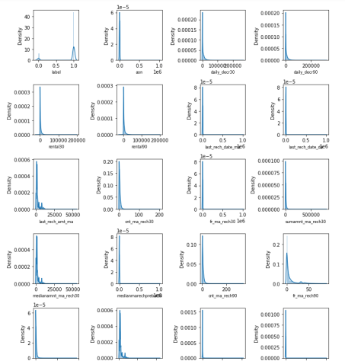
EDA DIST POLT

Slide 9
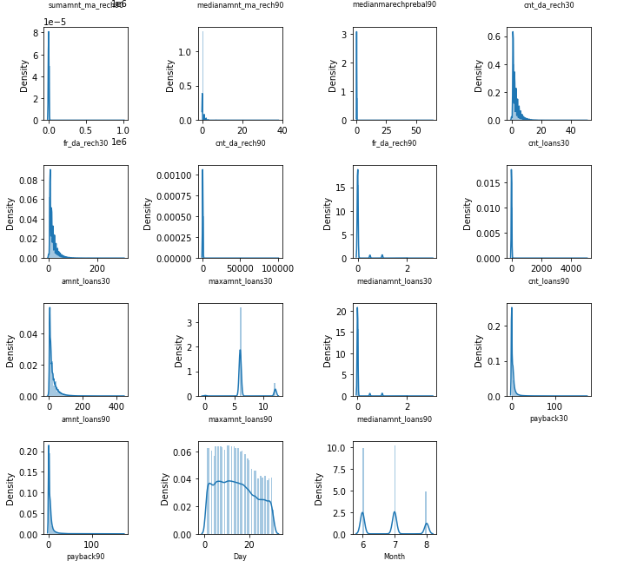

Slide 10
As we see the data is most of the columns right skewed and concentrated in one range. We need to treat them, as we have treated them with power transformer.

Slide 11
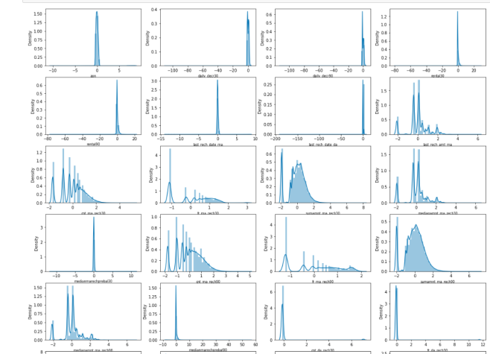
AFTER TRANSFORMATION

Slide 12
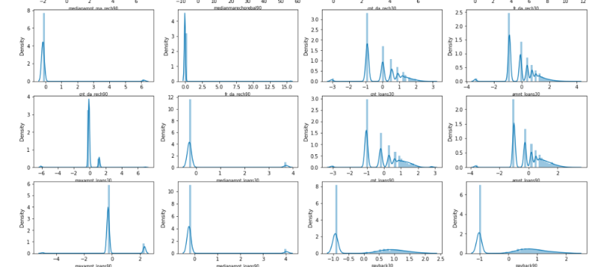

Slide 13
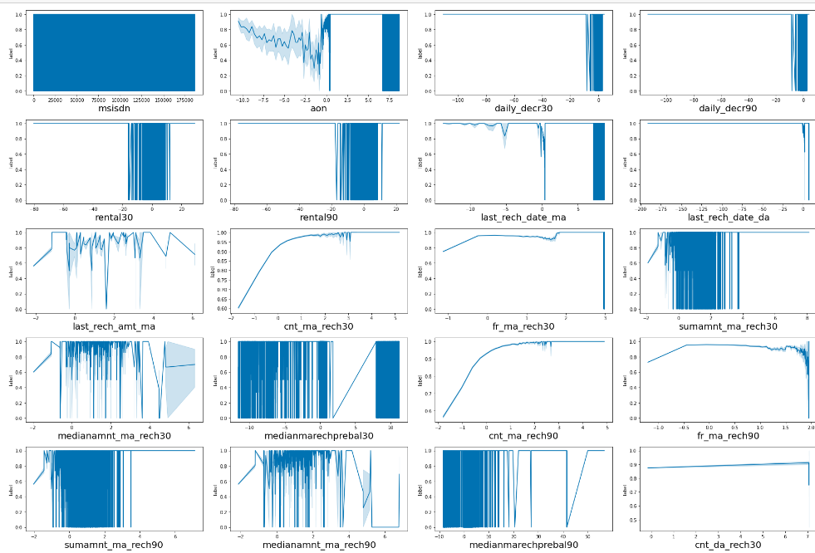
Feature Vs Label –Line Plot

Slide 14
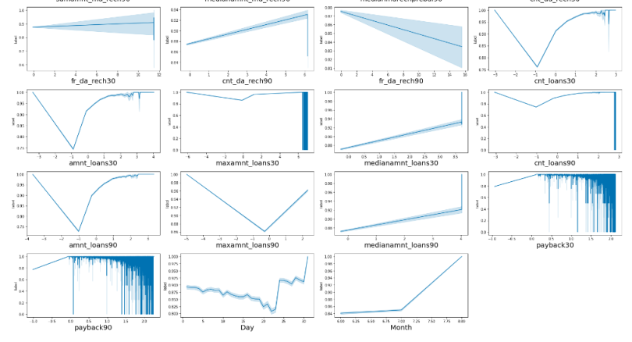

Slide 15
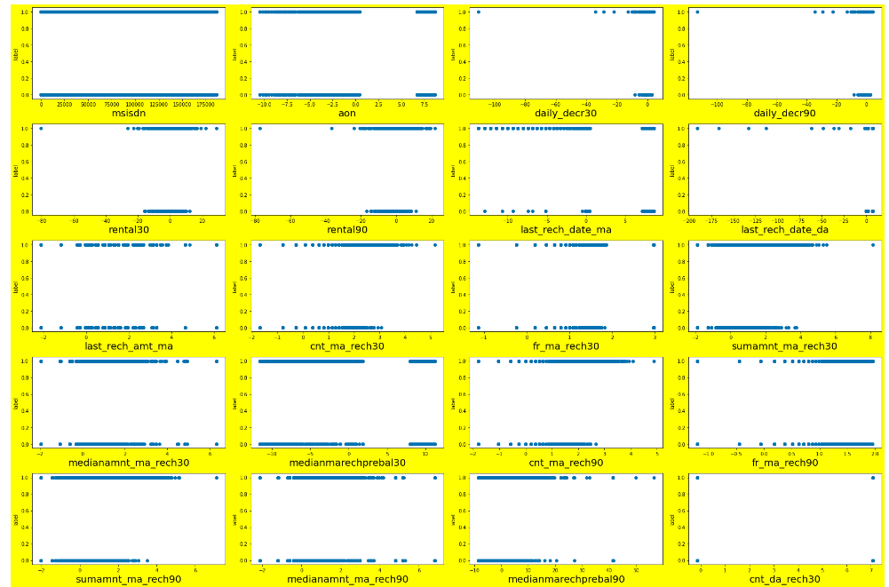

Slide 16
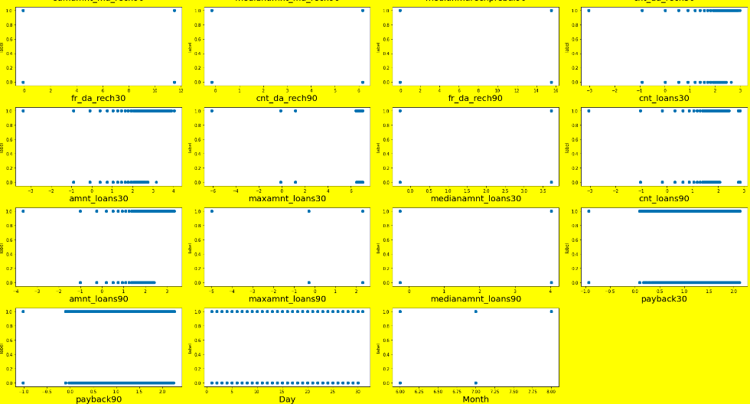

Slide 17
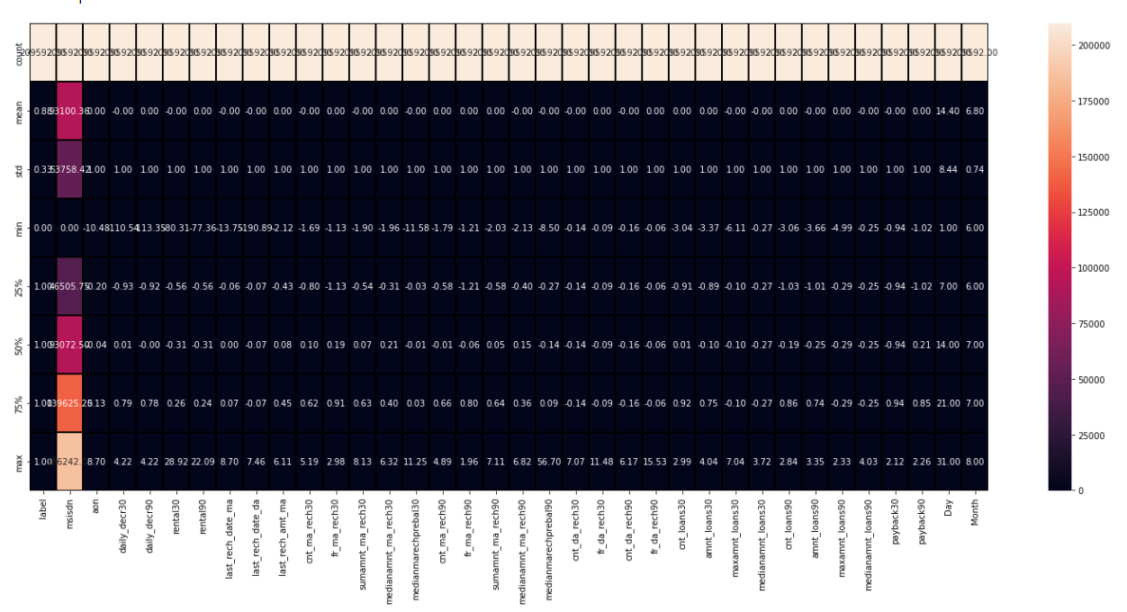
Describing the data

Slide 18
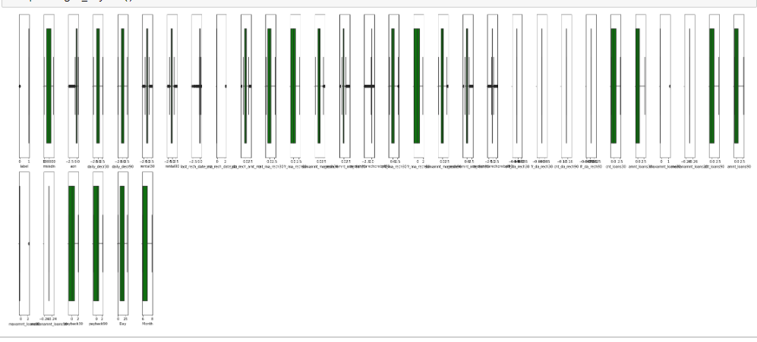
Final Outliers treatment – Box plot

Slide 19
Correlation with Label
last_rech_date_ma -0.021145
fr_da_rech90 -0.007887
fr_da_rech30 -0.002321
msisdn 0.001974
last_rech_date_da 0.005148
maxamnt_loans30 0.006544
Day 0.006824
cnt_da_rech30 0.009420
cnt_da_rech90 0.018636
medianmarechprebal30 0.030221
aon 0.031060
medianamnt_loans90 0.036233
medianamnt_loans30 0.046375
rental30 0.060683
maxamnt_loans90 0.069337
rental90 0.076943
medianmarechprebal90 0.089783
Month 0.154948
fr_ma_rech90 0.219901
amnt_loans30 0.230886
payback30 0.231644
cnt_loans30 0.233074
daily_decr30 0.237630
daily_decr90 0.239181

Slide 20
payback90 0.239740
fr_ma_rech30 0.241960
medianamnt_ma_rech90 0.251287
last_rech_amt_ma 0.261011
amnt_loans90 0.262090
cnt_loans90 0.262116
medianamnt_ma_rech30 0.276384
cnt_ma_rech30 0.344651
sumamnt_ma_rech30 0.356281
cnt_ma_rech90 0.362515
sumamnt_ma_rech90 0.366383
label 1.000000

Slide 21
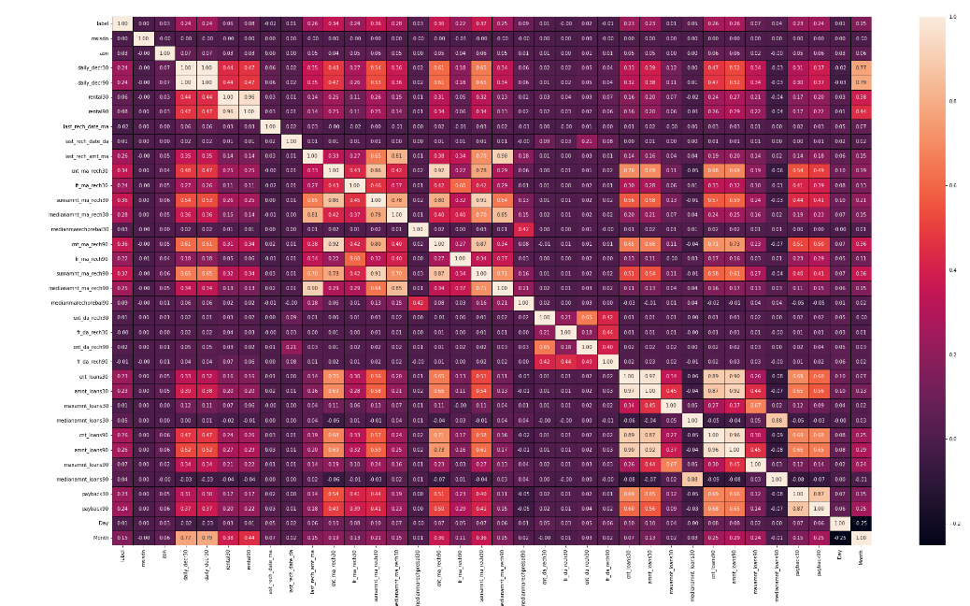
Feature VS Feature

Slide 22
Observations
From the heat map we see:
. We have many columns which are very correlated to each other, we see that we have 100% relationship between daily_decr30 and daily_decr90
. we see that rental 30 and rental90 have 96% relationship and amnt_loans30 and cnt_loans30 have 98% relationship with each other
. we see other columns as well having 80% or more relationship which can lead to multi collinearity problem so we will be using feature scaling and other techniques to remove the features

Slide 23
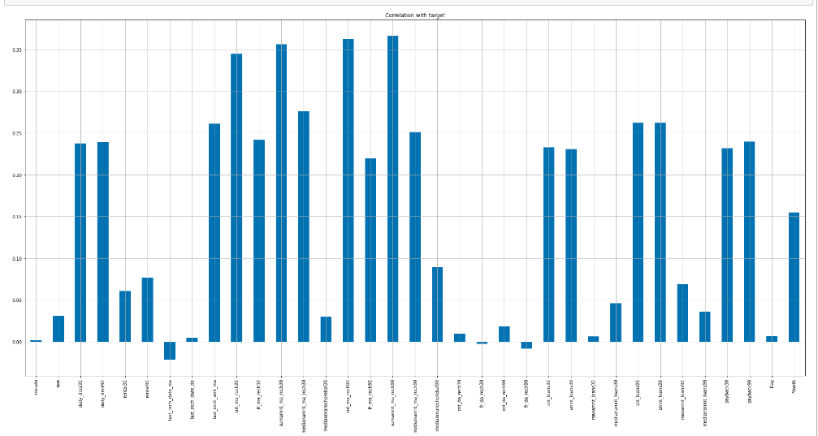
Bar plot visualization feature and label

Slide 24
Feature Selection- K best
Feature_name Score
16 sumamnt_ma_rech90 32496.962107
14 cnt_ma_rech90 31711.078501
11 sumamnt_ma_rech30 30472.719937
9 cnt_ma_rech30 28251.846485
12 medianamnt_ma_rech30 17334.352360
27 cnt_loans90 15462.225903
28 amnt_loans90 15458.884960
8 last_rech_amt_ma 15322.615796
17 medianamnt_ma_rech90 14126.653668
10 fr_ma_rech30 13033.356884
32 payback90 12780.792796
3 daily_decr90 12717.730990
2 daily_decr30 12543.456809
23 cnt_loans30 12039.724586
31 payback30 11884.084611
24 amnt_loans30 11802.074188
15 fr_ma_rech90 10650.019797
34 Month 5155.840941
18 medianmarechprebal90 1703.236565
5 rental90 1248.217381
29 maxamnt_loans90 1012.508165
4 rental30 774.659046
26 medianamnt_loans30 451.719495

Slide 26
Observations
We see that the feature sumamnt_ma_rech90 32496.962107 cnt_ma_rech90 31711.078501 sumamnt_ma_rech30 30472.719937 cnt_ma_rech30 28251.846485 is the best as the score they have are greater than 2500 approx which is really high,, the rest of them have a good impact or influence on the label, but we are only performing this step as a way to analyze the data even further , We see that correlation showed different features and Kbest is showing different so we will move on and we will do some more analysis

Slide 27
PCA
We are going to check how many features we need to be able to cover as much of the data and come out with a decent model which can factorize all the features as well , PCA is a dimensionality tool which can help us

Slide 28
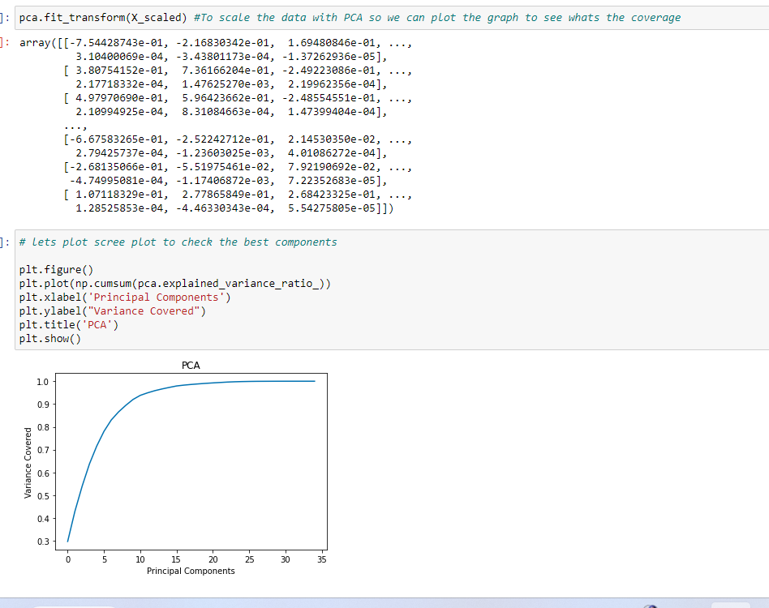

Slide 29
We see that in order to cover 95% - 100% of the data we need to have only have 12 features and we can remove the rest , We will use the Kbest to decide which features are the best and see if we should remove any feaures ,

Slide 30
Since we identified that we need only 12 features to make any impact on the label we have done PCA feature engineering and used those features

Slide 31
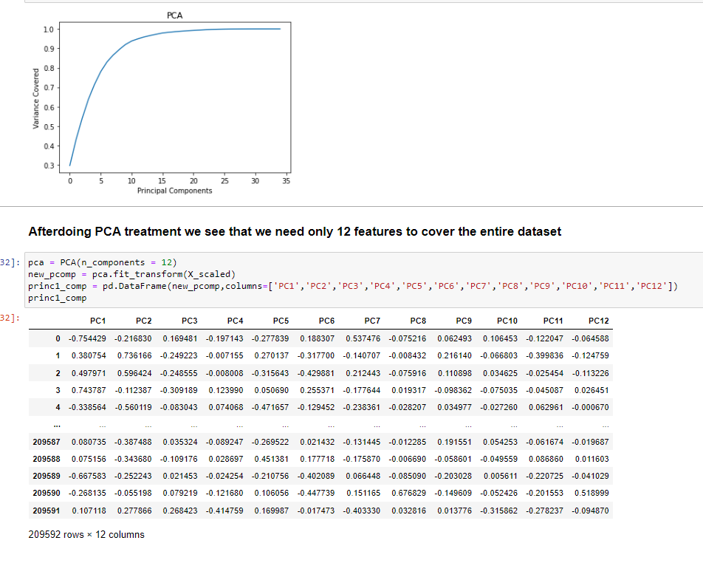

Slide 32
Training the model
Train test split
Selecting the right model

Slide 33
Model dashboard IN Per%
MODEL | TRAIN ACCURACY | TEST ACCURACY | PRECISION SCORE | RECALL SCORE | ROC AUC Train score | ROC AUC Test score | CV SCORE
LOGISTIC REGRESSION | 88.01 | 88.01 | 66 | 66 | 82 | 82 | 88
DECISION TREE | 99 | 84.57 | 66 | 66 | 91 | 91 | 84.5
KNN CLASSIFIER | 91.10 | 87.06 | 72 | 68 | 94 | 80 | 87.06
XGBOOST | 89.22 | 90.08 | 77 | 71 | 91 | 91 | 89.12
SVC | 88.95 | 89.07 | 77 | 67 | 83 | 83 | 89.01

Slide 34
We will go with XGB classifier model as :-
- the model gives the highest accuracy and other f1 and precision scores
- the model has lowest error in the confusion matrix
- the model is shown that it has train 94% and 89% in ROC AUC , which is way better that others
- we also see that the other models we test may have closer scores like Decision tree but the computation time is very high and we can’t go with it
- Overall we need to improve the cvscore and accuracy in xgboost and if we can do hyperparameter tuning to do it , this will be the best model we can choose

Slide 35
FINALIZED MODEL
HYPER PARAMETER TUNING
We have increased the score bya little bit ,
Snap in the next slide

Slide 36
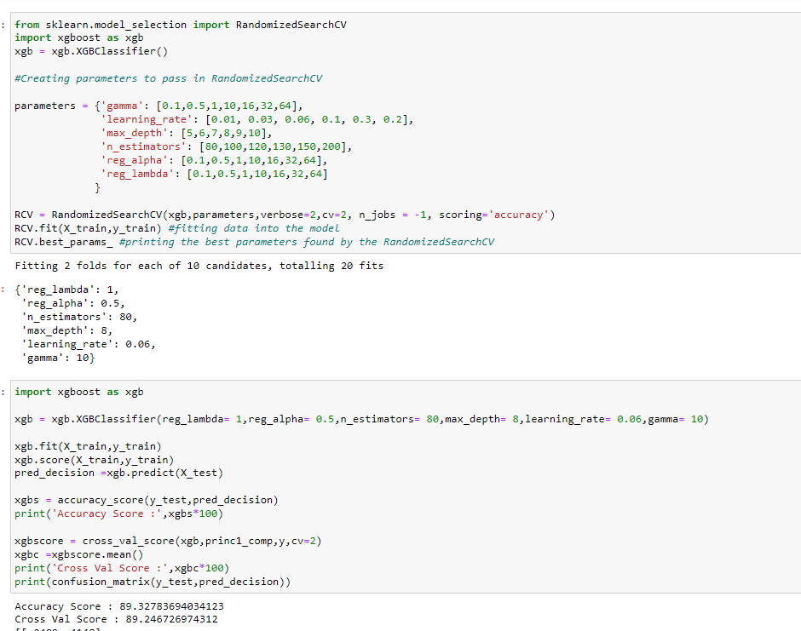

Slide 37
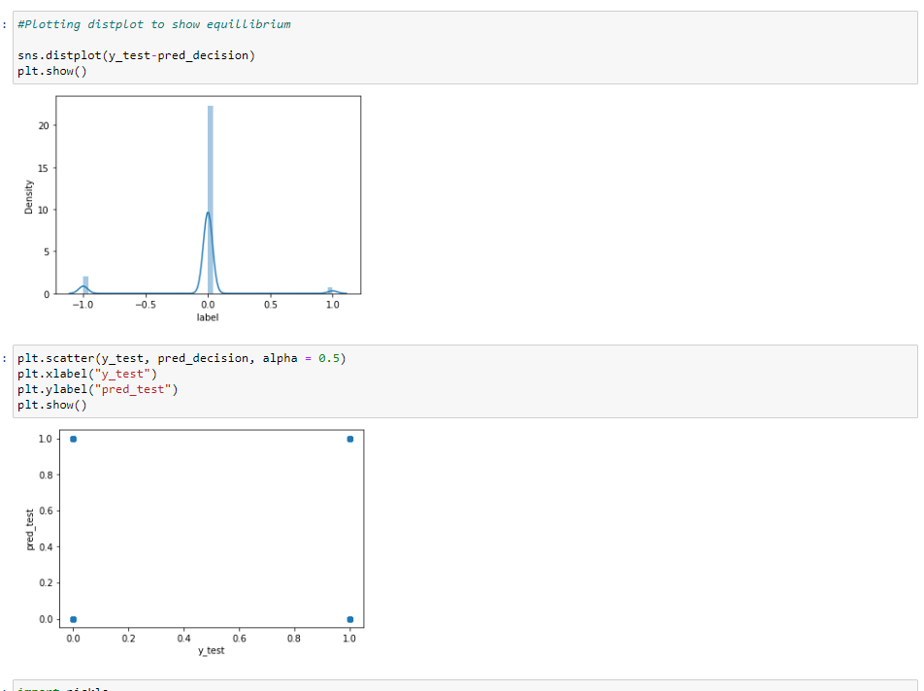
Graphs of the selected Model

Slide 38
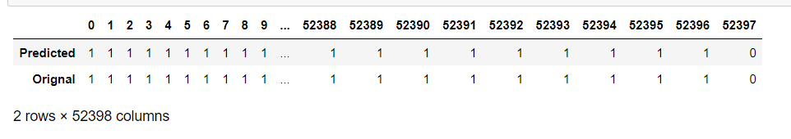
Concluding predictions

Slide 39
Conclusion
An accuracy score of 90% for a binary classification project is considered to be quite high, and suggests that the model is performing well in distinguishing between the two classes of interest (in this case, loan defaults and non-defaults). The fact that the XGBoost classifier performed the best among the models tested further validates the effectiveness of this algorithm. However, it's important to keep in mind that accuracy is not always the most relevant metric for evaluating a classification model's performance. It is important to look at the other evaluation metrics like precision, recall, F1-score and AUC-ROC to get the full picture of how well the model is performing, In our case as compared to the rest of the models we see that the Xgboost is performing the best , we do see that the confusion matricx has a significant amount of errors but since the data set is huge it only constitutes for 10-15% of the data . We also need to remember thatw e were not allowed to remove more that 8% of outliers and when we used Zscore we had 18% of data which we had to remove which was not possible ,.
Also important to note that this high accuracy score should be viewed in the context of the specific dataset and problem, and may not generalize to other datasets or real-world scenarios.
Achieving this score is a good sign that data science is really going to make a positive impact in the business decisions taken by management with regards to who they need to give the loan to as opposed to who they should not .

Slide 40
Further scope
In the Micro finance defaulter project, we aimed to identify problem-solving approaches and methods to predict loan defaults using machine learning binary classification. We identified a set of features, such as daily amount spent from the main account, average main account balance, number of days till last recharge, and number of times the main account got recharged in the last 30 days. We then tested a variety of classification algorithms and found that the Xgboost classifier performed the best, with an accuracy score of 90%. Through this project, we can conclude that factors such as financial spending habits and account recharge history can play a significant role in determining the likelihood of loan defaults. Our results can be used to assist microfinance institutions in identifying and managing potential loan defaults, ultimately improving their financial stability and sustainability.

